Slide 1

PROJECT DEVELOPMENT PHASE
DELIVERY OF SPRINT 4
Date | 12.11.2022
TeamID | PNT2022TMID14014
Project Title | Project - Retail Store Stock Inventory Analytics

Slide 2
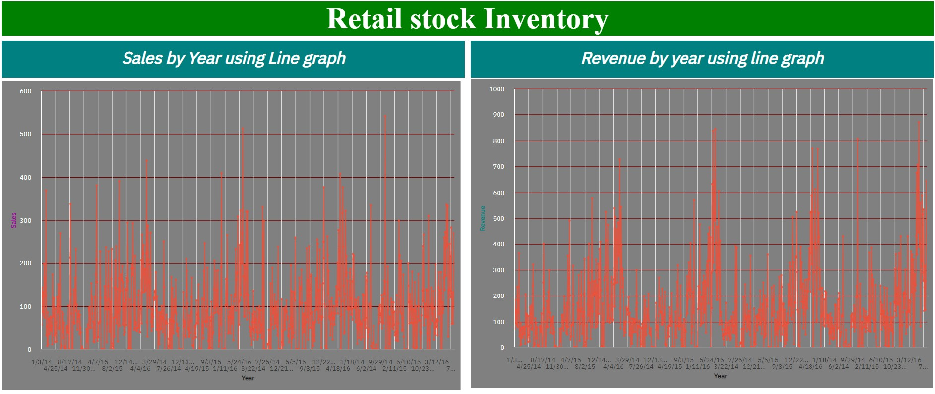
1.YEARLY SALES AND REVENUE

Slide 3
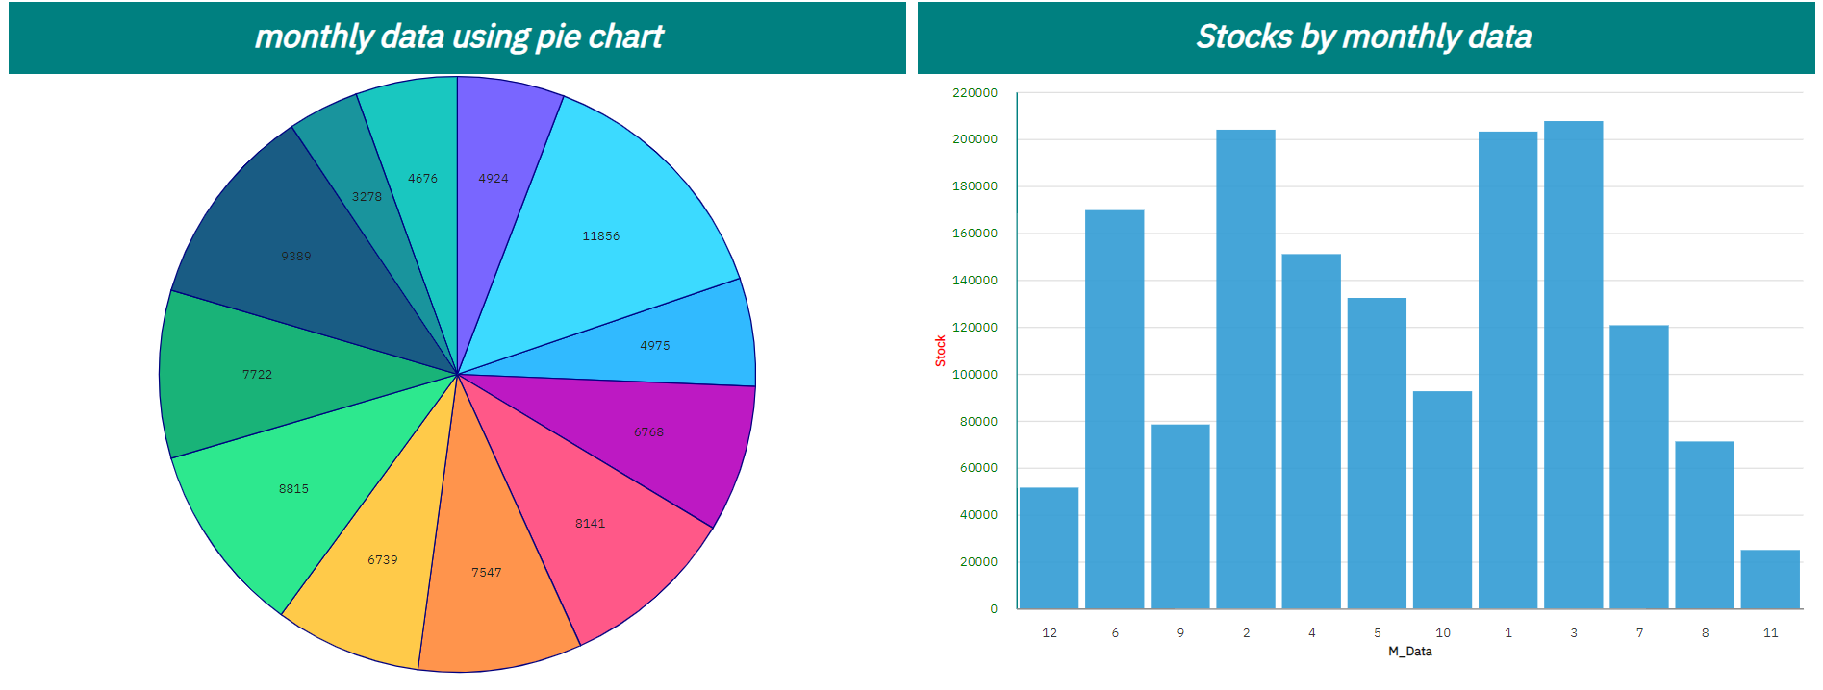
2.MONTHLY WISE STOCK,SALES

Slide 4
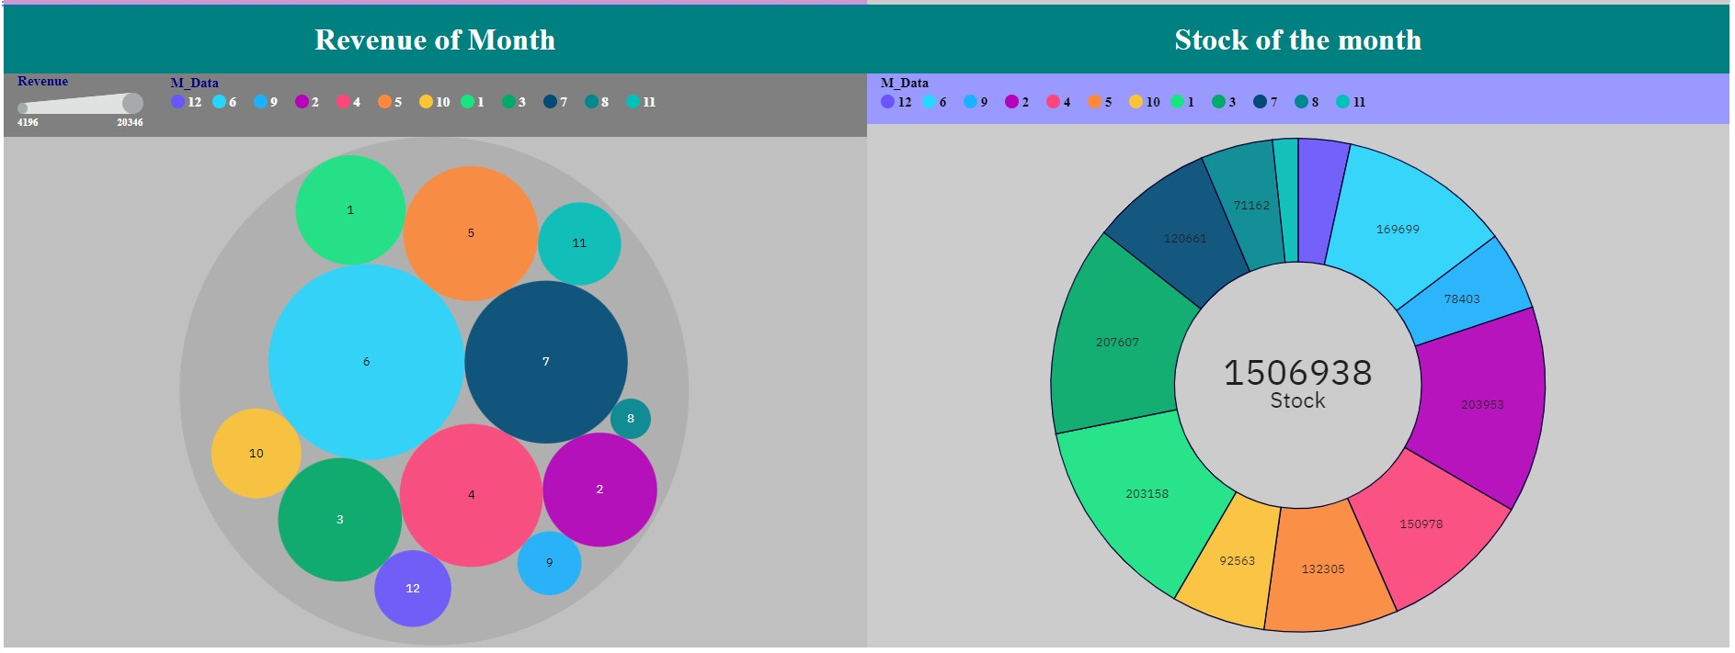
3.MONTHLY WISE REVENUE , STOCKS

Slide 5
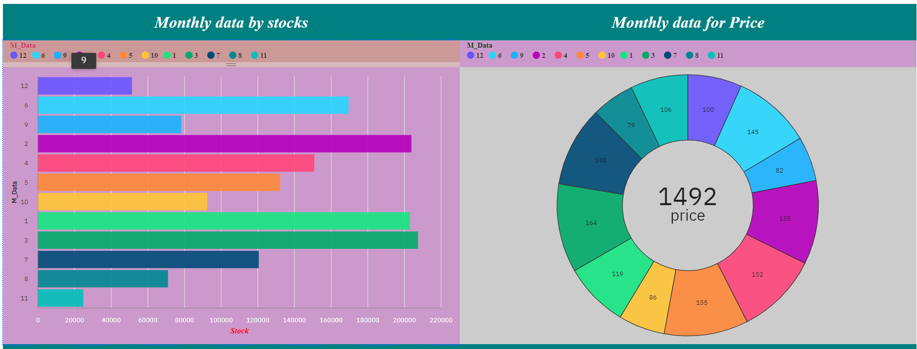
4.PRICE OF STOCKS AND MONTHLY DATA

Slide 6
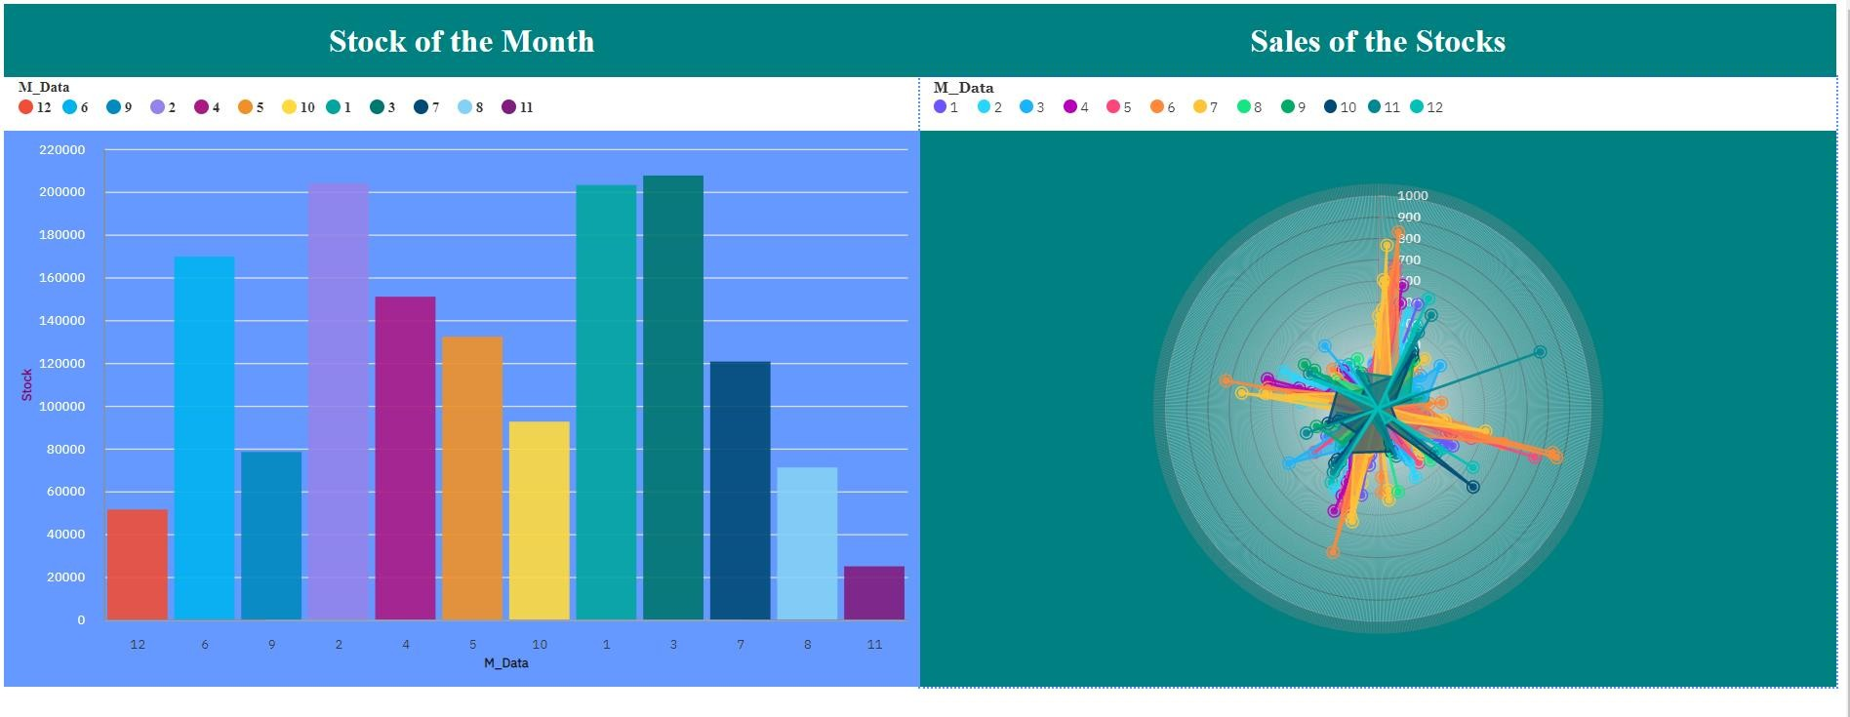
5.MONTHLY DATA ,STOCKS ,SALES

Slide 7
LINKS FOR REPORT
▶ Link1:https://us1.ca.analytics.ibm.com/bi/?pathRef=.my_folders%2FSPRINT 4R&action=edit
▶ Link2:https://us1.ca.analytics.ibm.com/bi/?pathRef=.my_folders%2FSPRINT
4R&action=edit

